Slide 1
Formula SAE
Powertrain
67% Hardware Update
Damian Boniella, Matt Gingold, Tobin Lanford, Joey LeBlanc, Lucille Longhurst

Slide 2
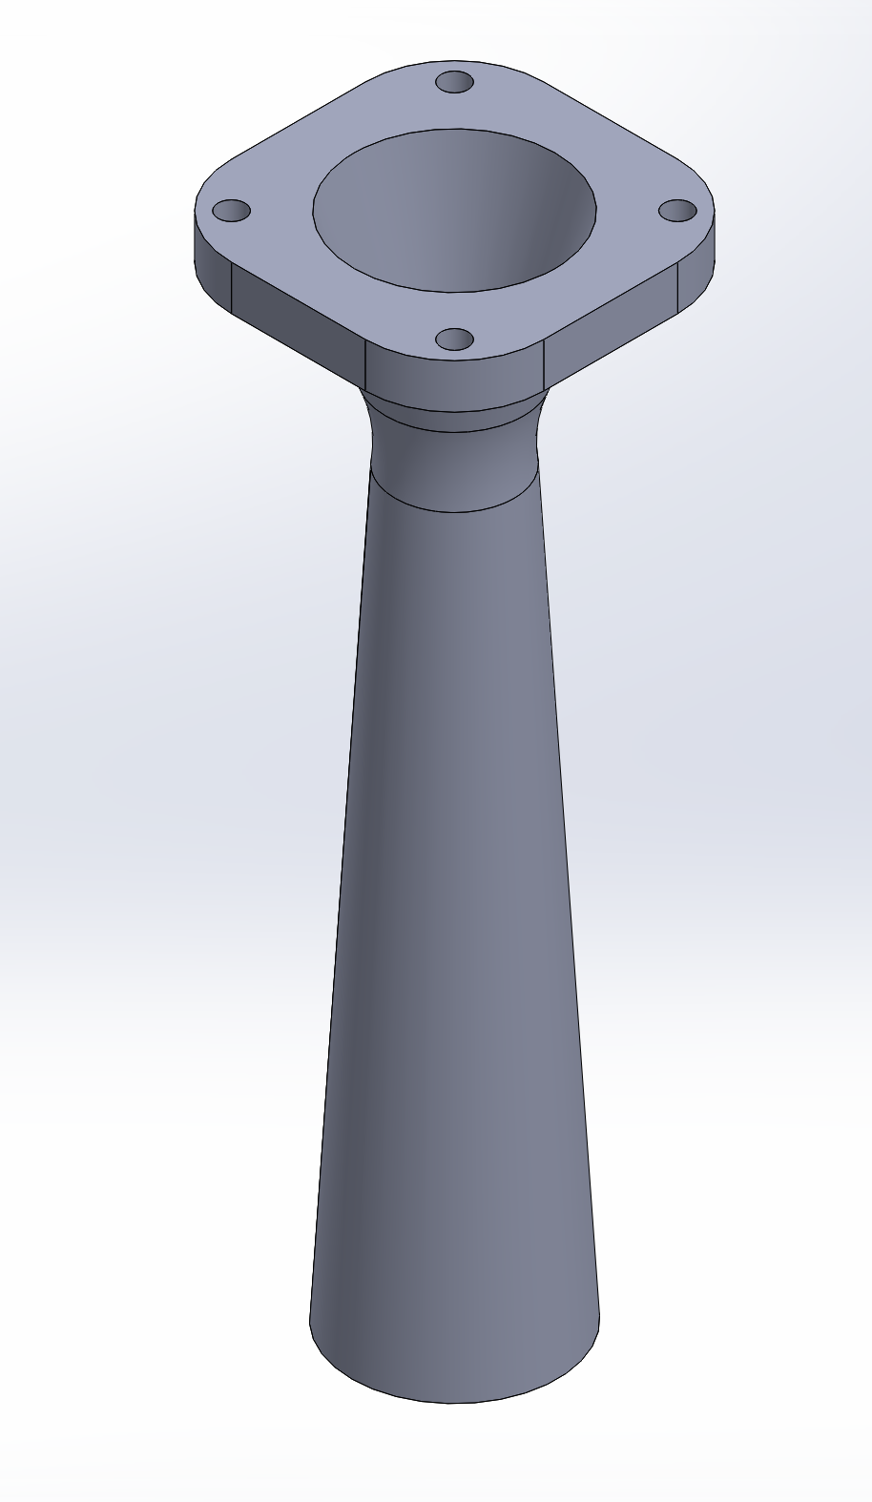
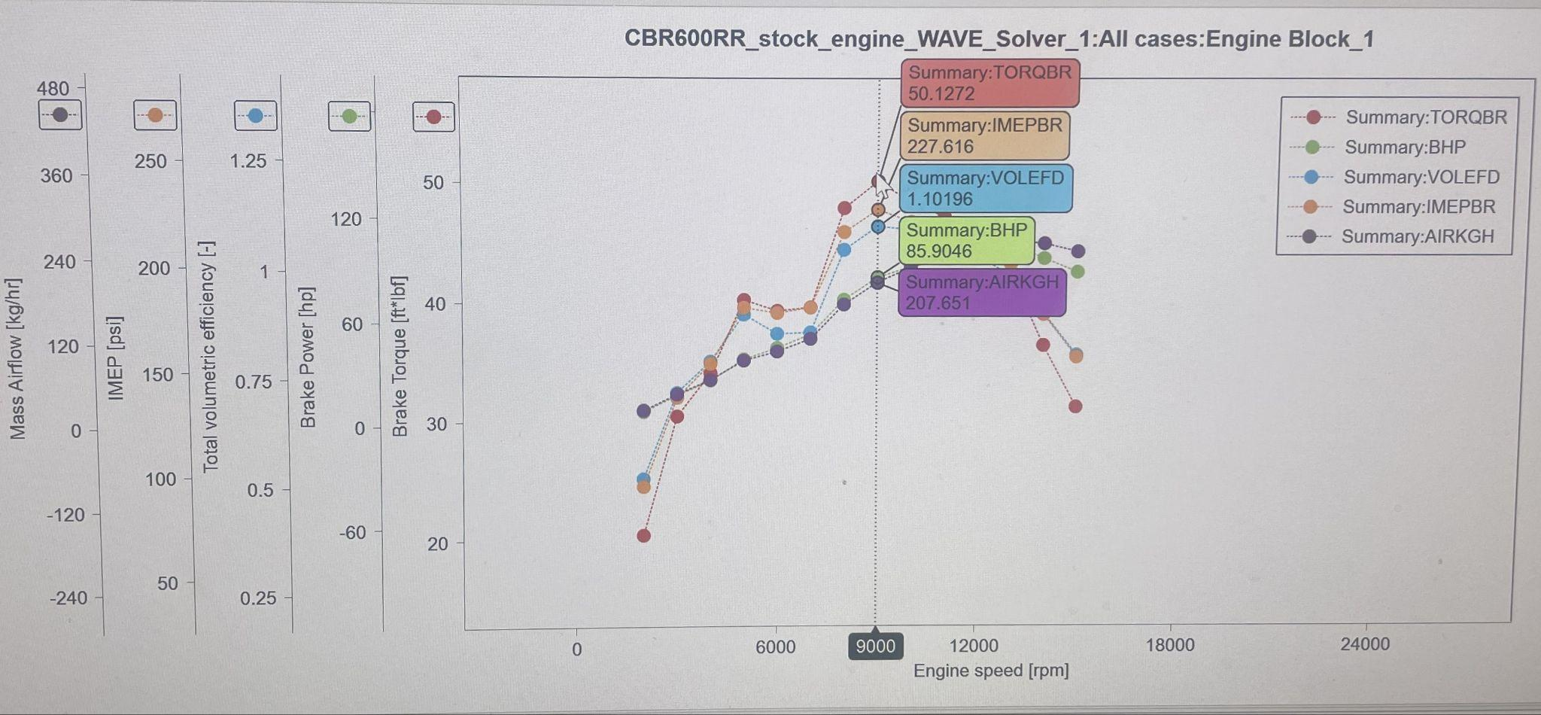
Intake Tuning

Slide 3
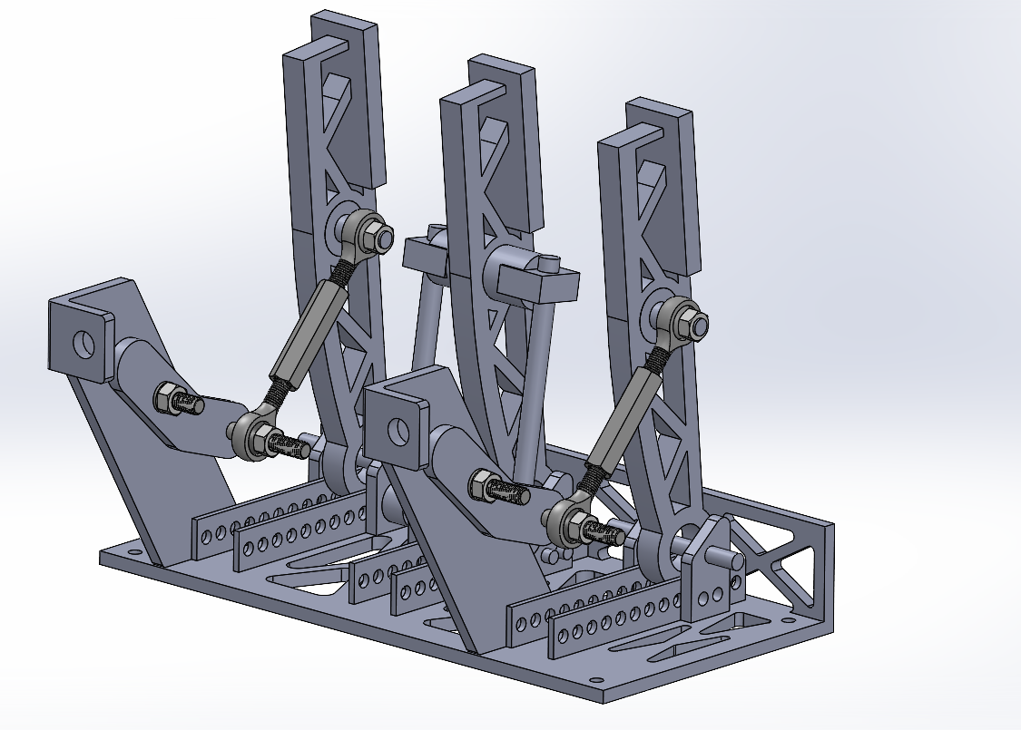
Pedal Box

Slide 4
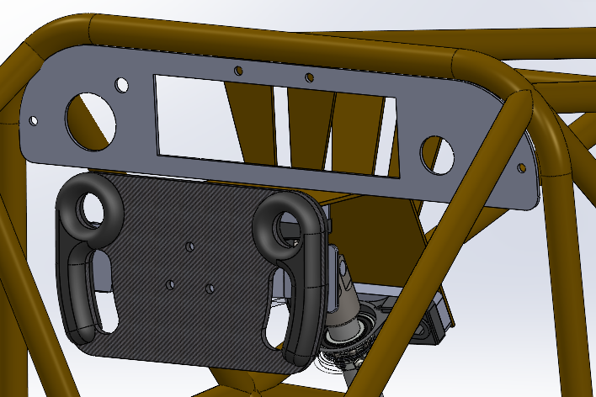
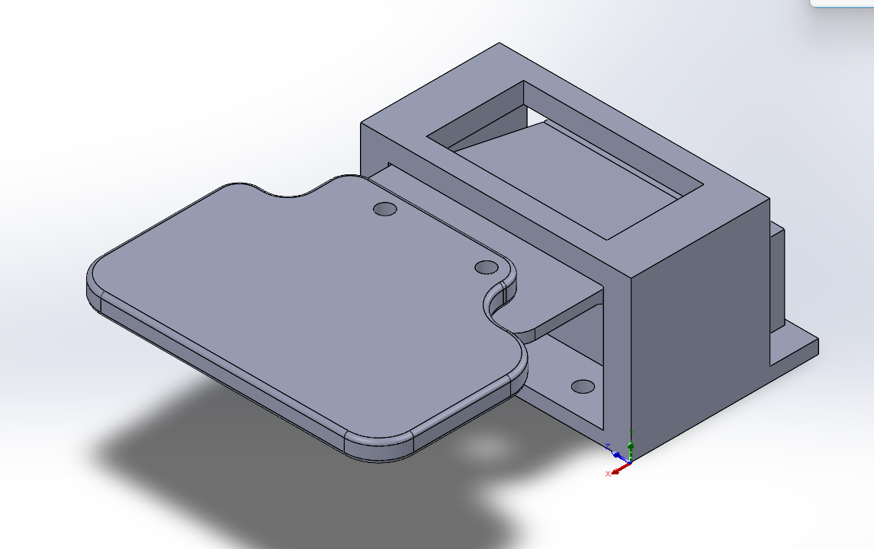
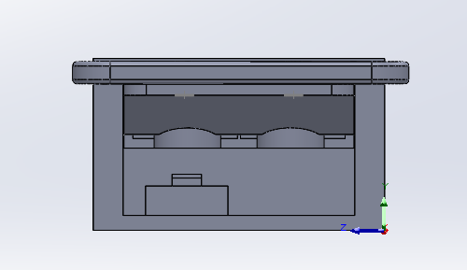
Shifting System

Slide 5
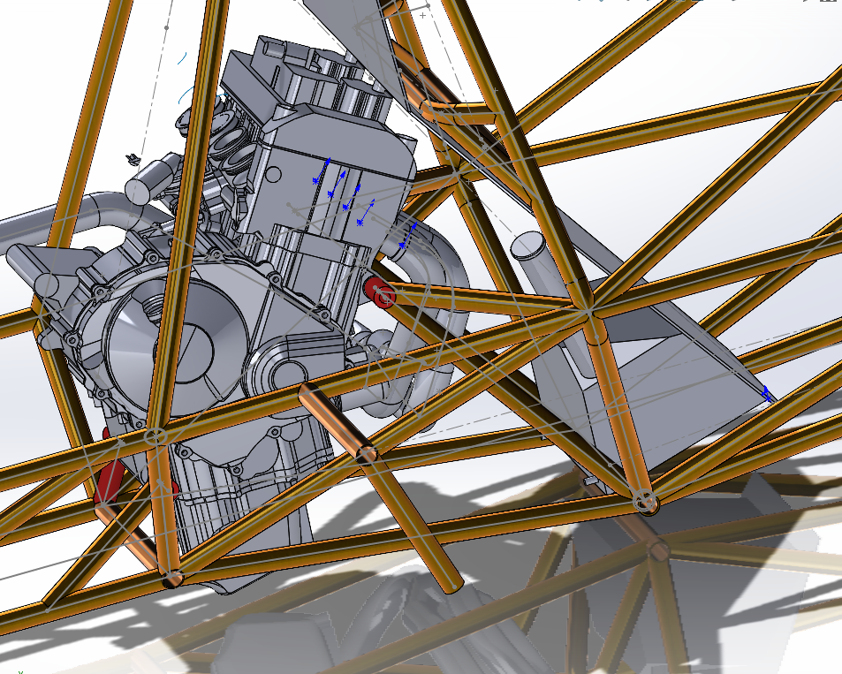
Gas Tank

Slide 6
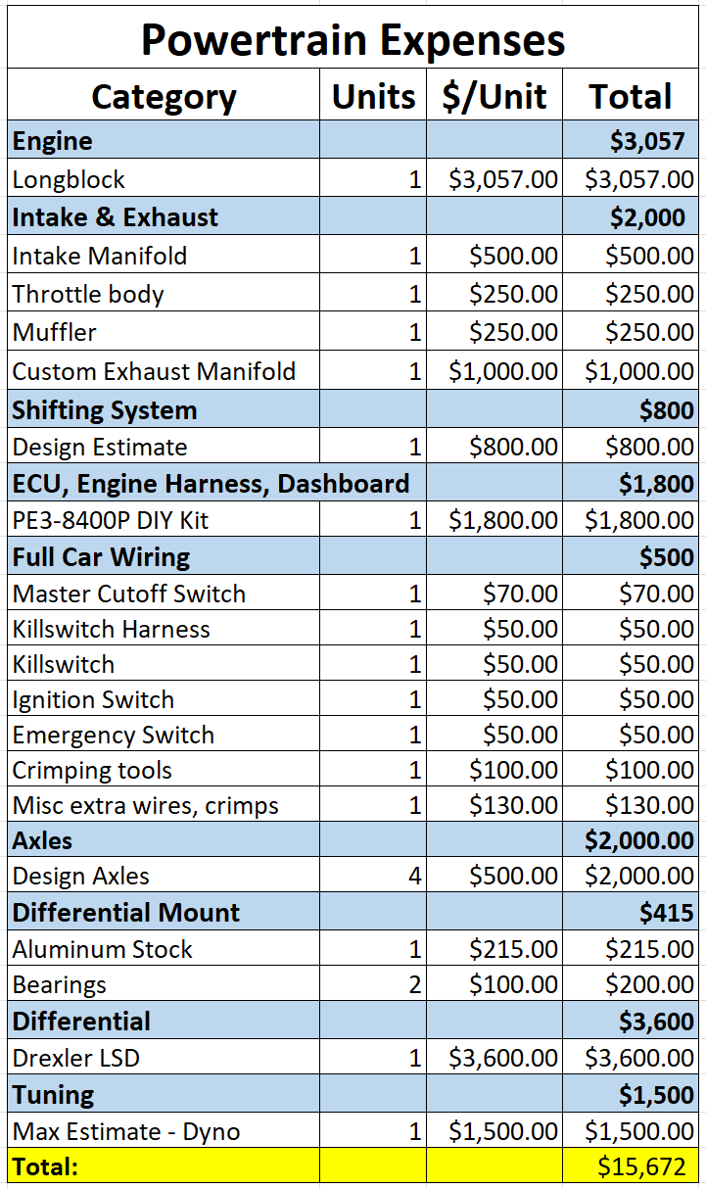
Top Level Budget

Slide 7
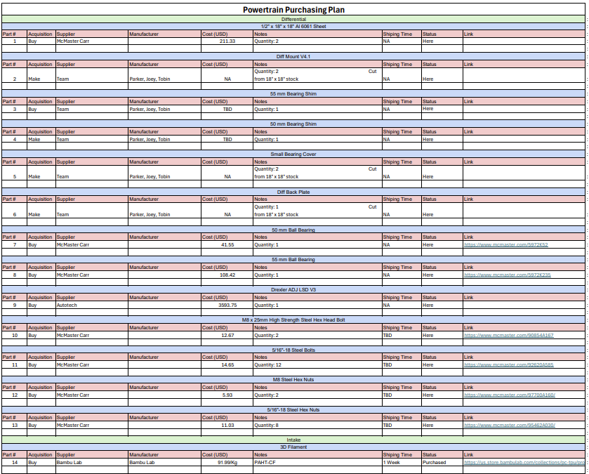
Purchasing Plan - Diff Mount

Slide 8
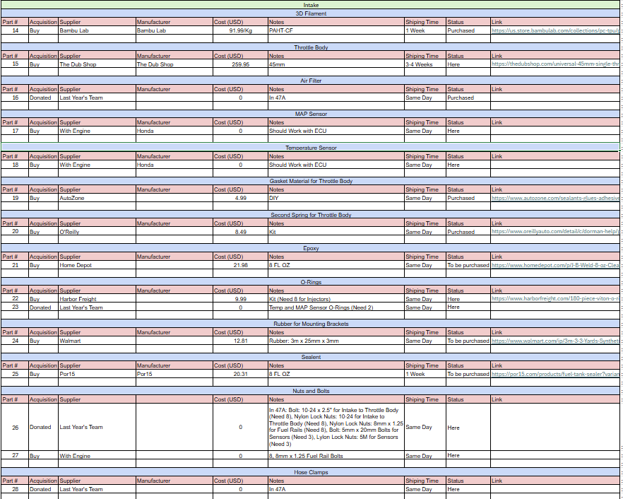
Purchasing Plan - Intake

Slide 9
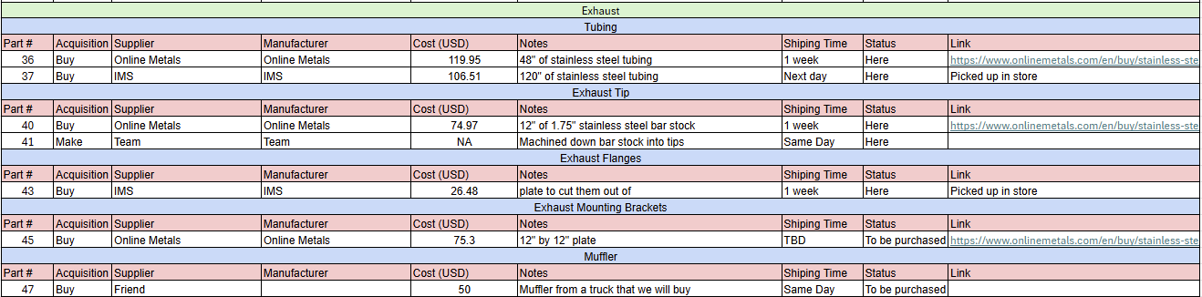
Purchasing Plan - Exhaust

Slide 10
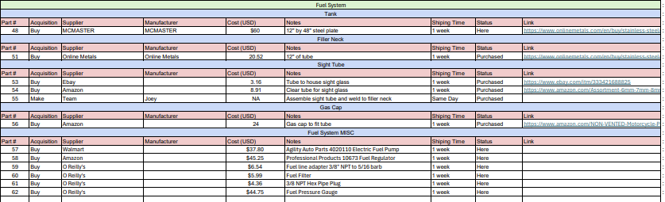
Purchasing Plan - Fuel System

Slide 11
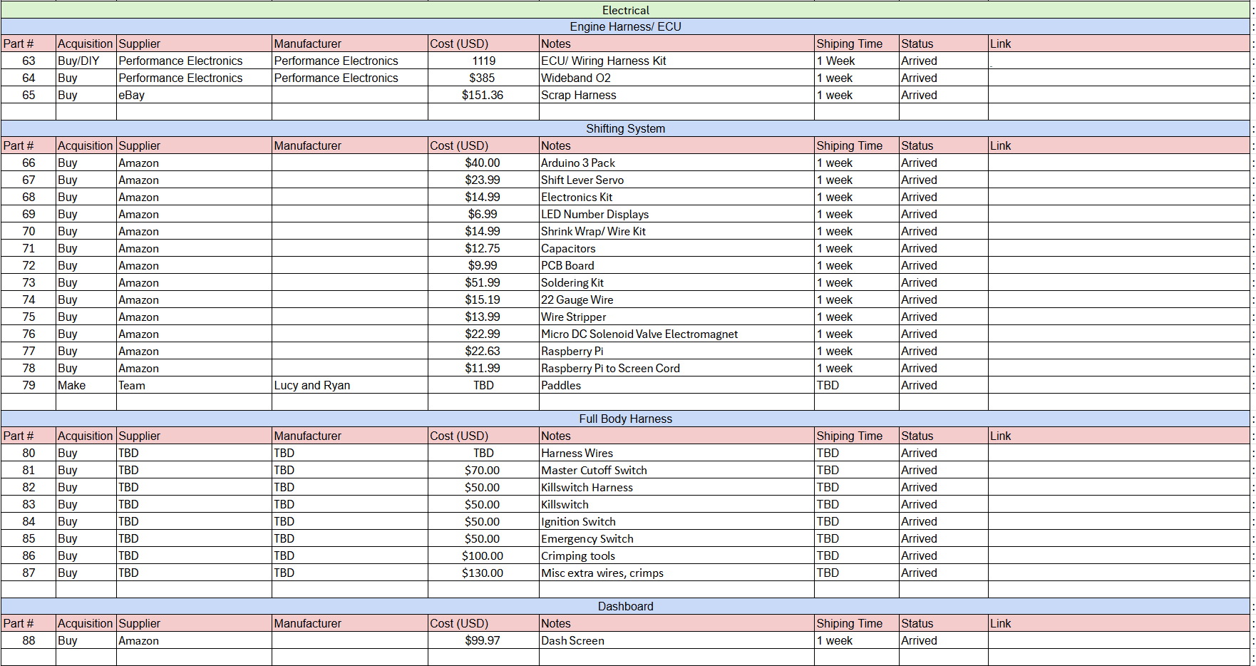
Purchasing Plan - Electrical

Slide 12
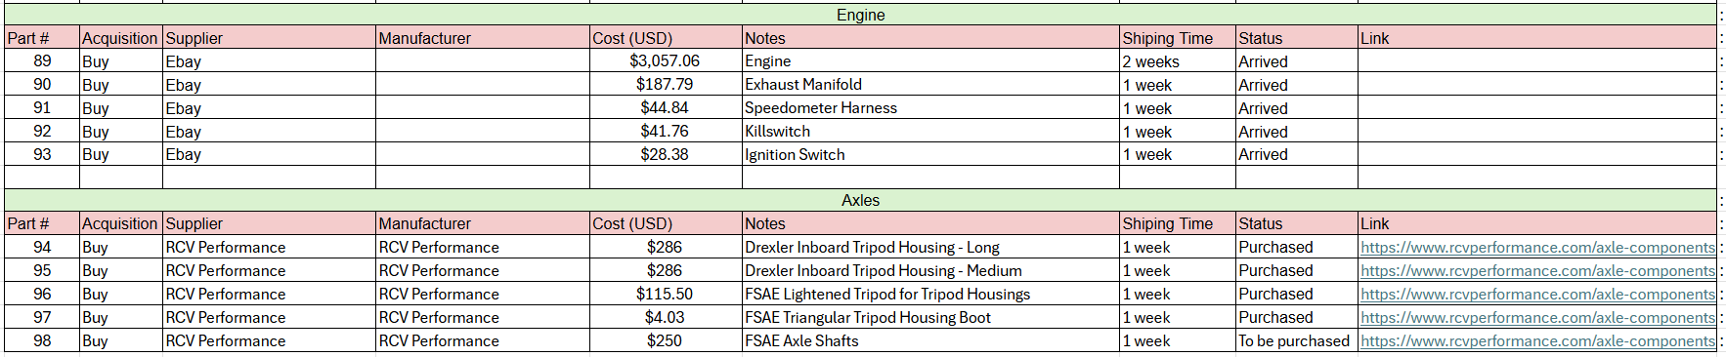
Purchasing Plan - Engine & Axles

Slide 13
Percentage Purchased

Slide 14
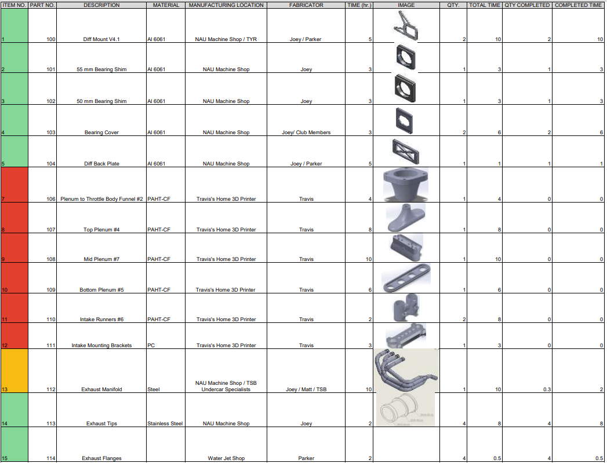
Manufacturing Plan

Slide 15
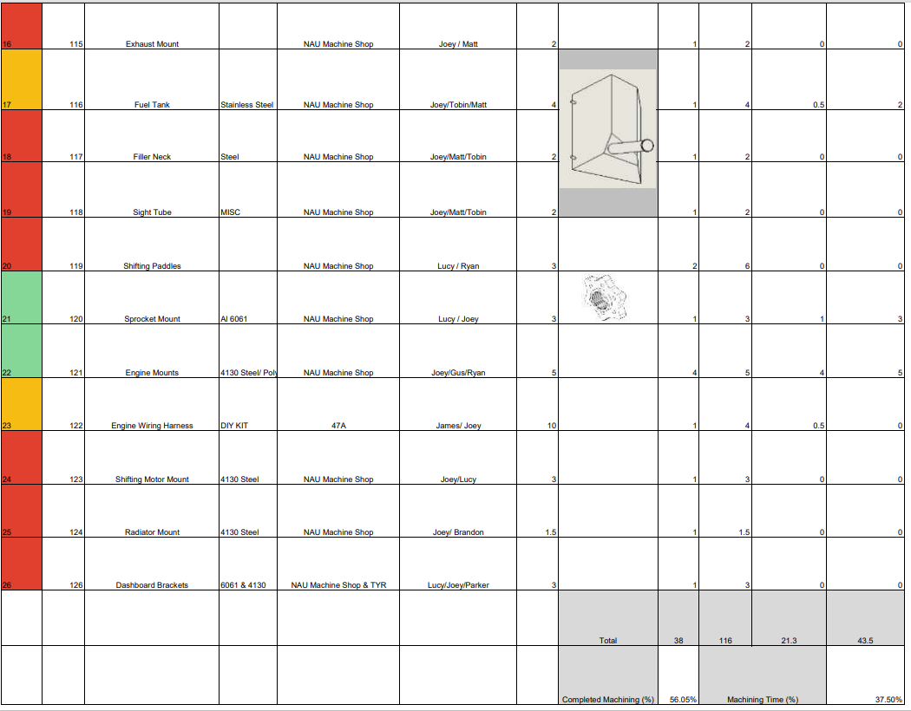
Manufacturing Plan

Slide 16
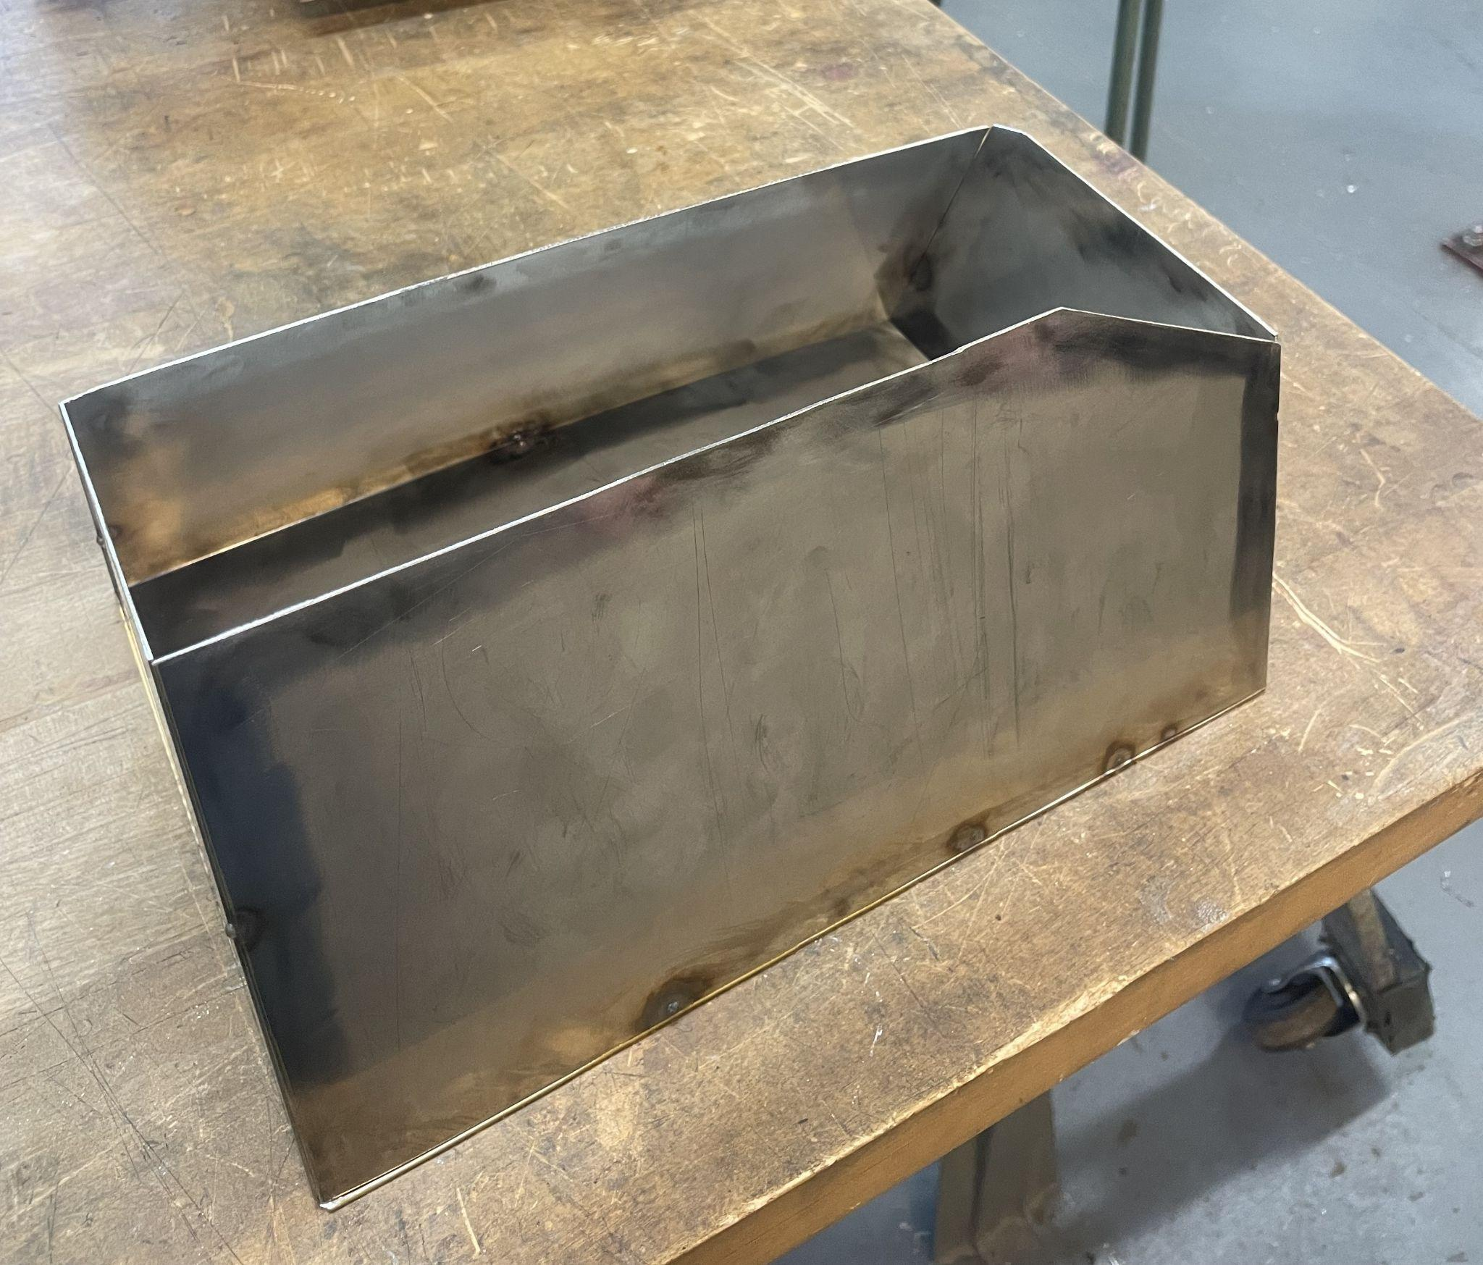
Demonstrations!

Slide 17
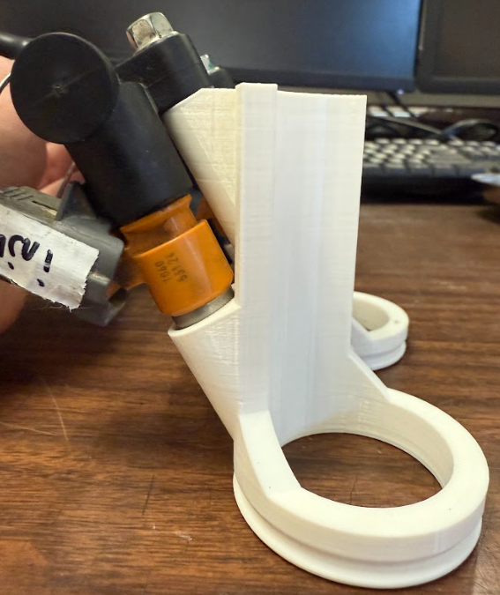
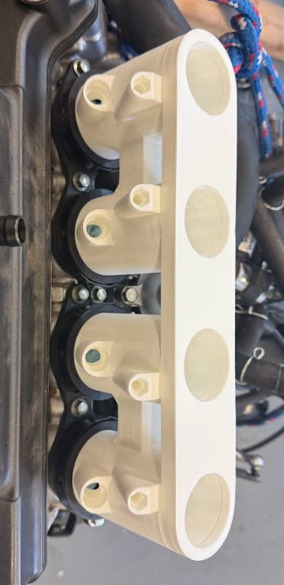
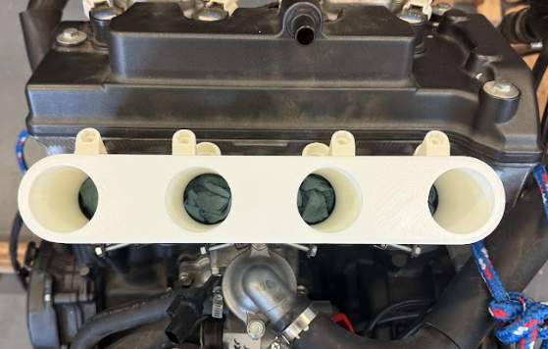
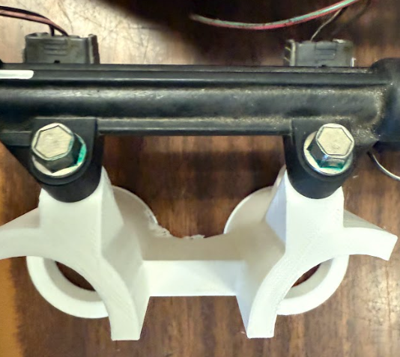
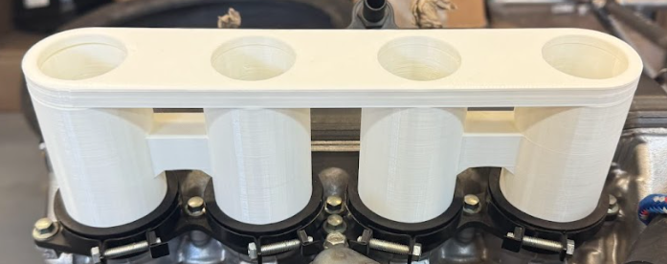
Intake 3D Prints

Slide 18
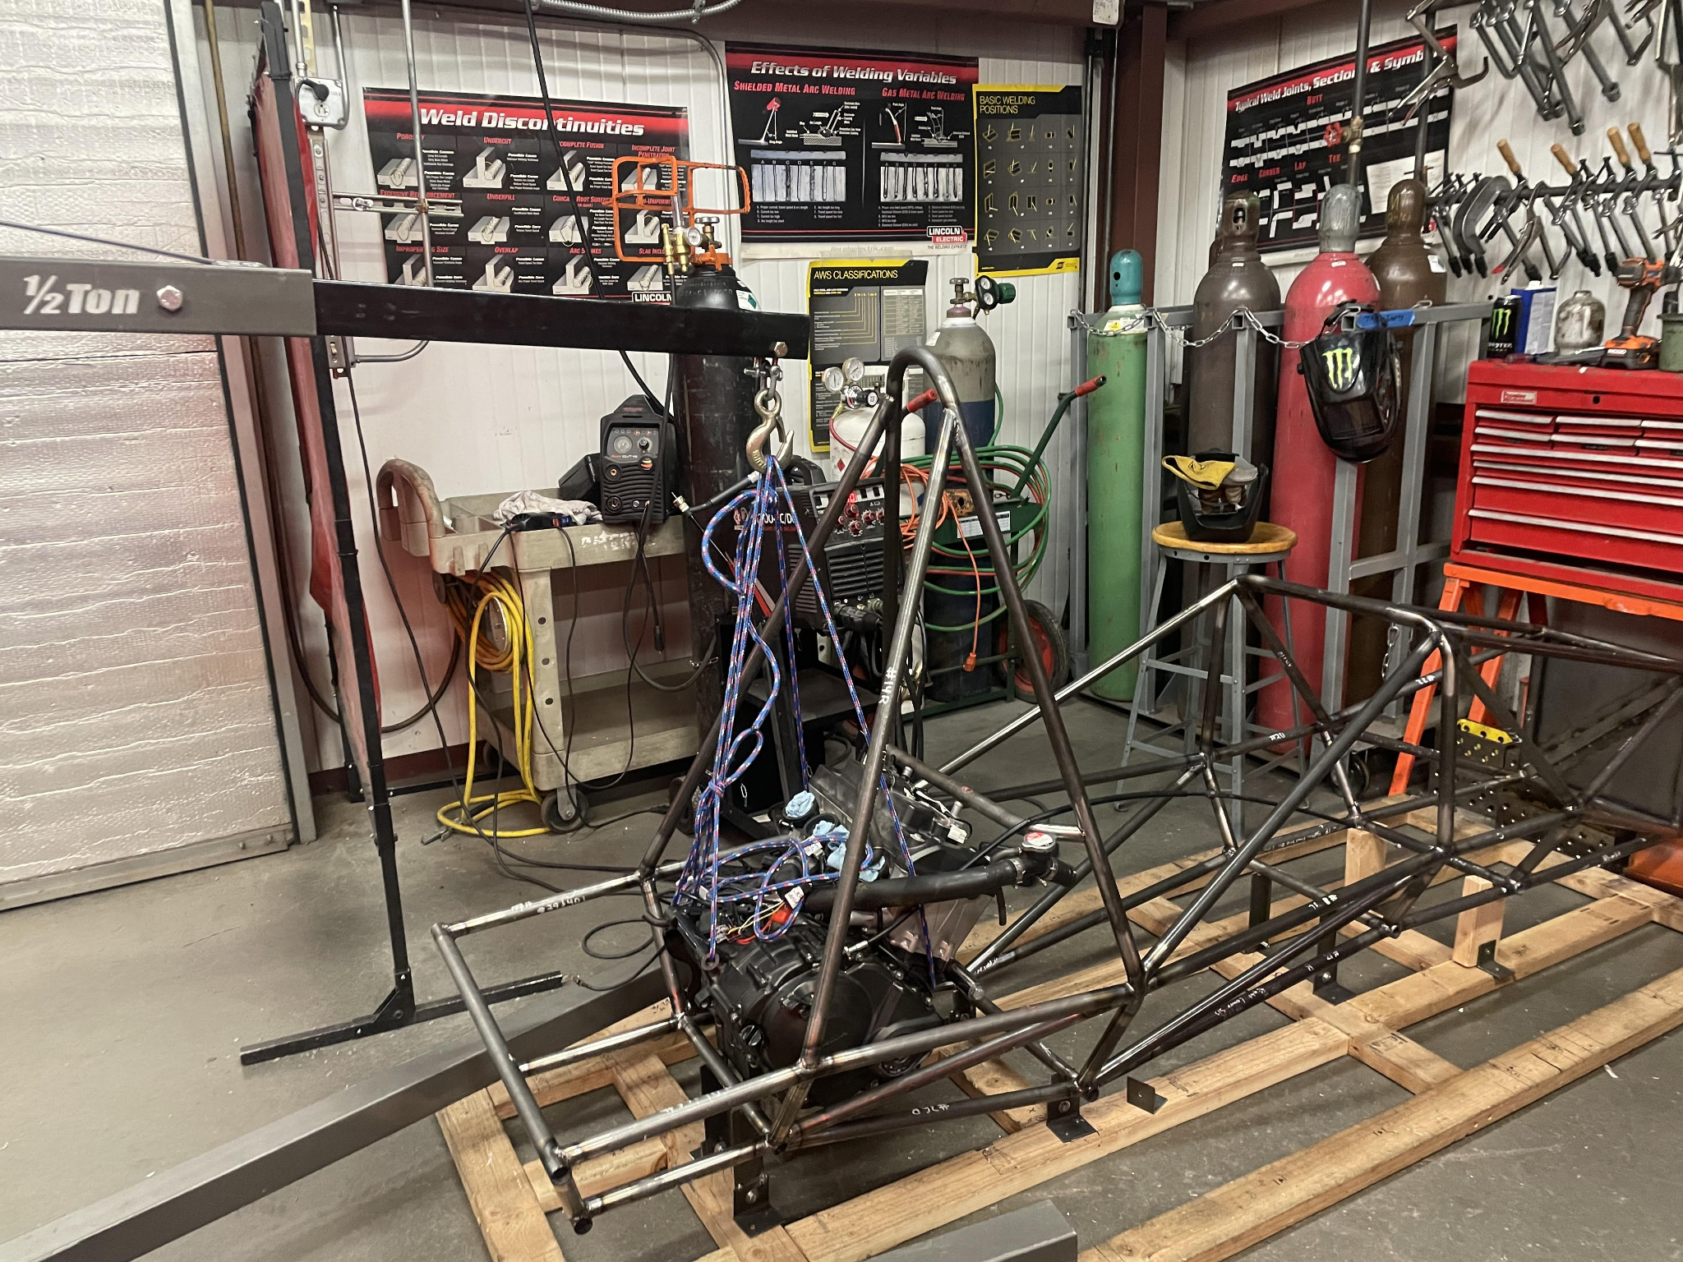
Engine Installation

Slide 19
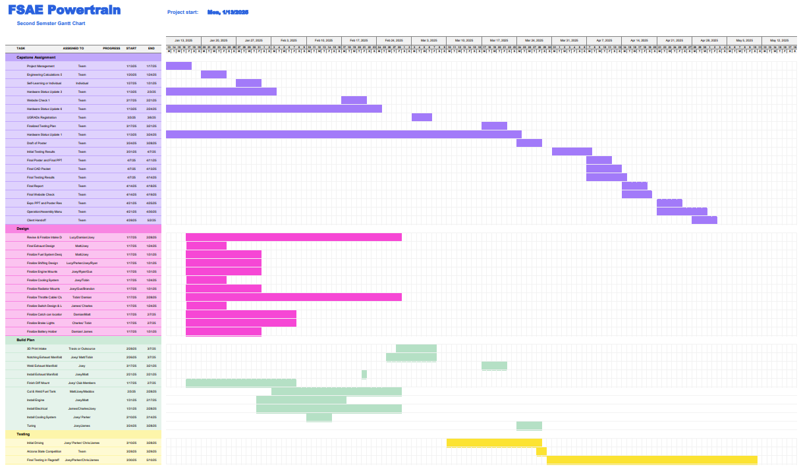
Gantt Chart

Slide 20
QUESTIONS?
THANK YOU

